Slide 1

Theory of Production:
Short-Run Analysis
Ilie Baluta Ioana Antonia
Group 1719
Series D

Slide 2

What is it?
The Theory of Production explains the principles by which a business firm decides how much of each commodity that it sells (its “outputs” or “products”) it will produce. And how much of each kind of labor, raw material, fixed capital goods, etc., that it employs (its “inputs” or “factors of production”) it will use.

Slide 3

Long run vs short run
- The Short-Run is the period in which at least one factor of production is considered fixed. Usually, capital is considered constant in the short-run.
- In the Long-Run, all factors of production are variable, while in the very long-run all factors of production are variable and research and development is possible.

Slide 4
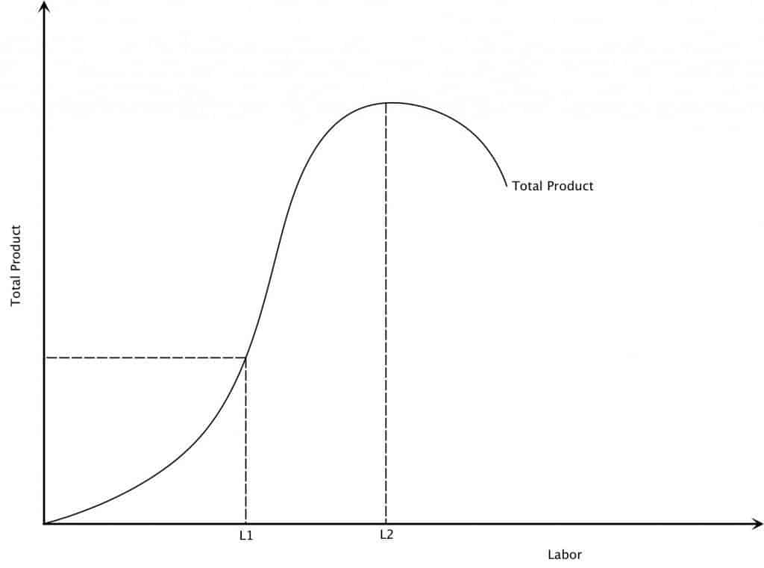
If more and more of a variable Factor of Production is used in a combination with a fixed factor of production, marginal product, then average product will eventually decline. The law of diminishing marginal returns determines the behavior of output in the short-run. Think of a pizzeria, with tables, chairs, and ovens (fixed factor of production). With no workers, the output is zero, with one worker the output is ‘x’ units. The worker takes orders, makes pizzas, cleans tables and serves the bill. If there are two workers, the second worker can do the same work as the first, and the output will be 2x units. They can specialize and further increase output.

Slide 5
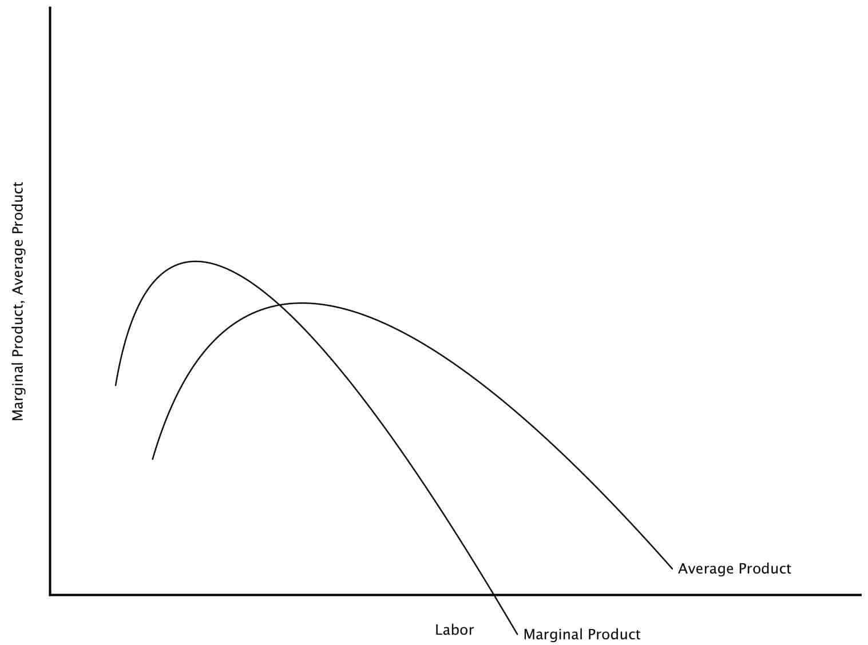
Average Product (AP)
Total Product / Variable Factor of Production. Average Product is maximum at the point that the Total Product is the steepest.
Marginal Product (MP)
Marginal Product is the change in the total product as a result of changing the variable factor of production by 1 unit. Ex: When one more chef is added, and production increases to x units when the second worker has hired the output increases by more than 2x units.

Slide 6

-If Marginal Product > Average Product, then Average Product will rise
-If Marginal Product < Average Product, then Average Product will drop
-If Marginal Product = Average Product, then Average Product will be at maximum
For example: If you think of scores, in Jack’s sixth test (marginal), he gets a score higher than his average, then his average will increase. If in the next test (marginal) he gets a score lower than his average, then his average will drop. If he gets a score that’s the same as his average, then his average won’t change.

